Slide 1

Anchor Tag <a>… </a>
Links are fundamental to navigating the web. In HTML, links are created using the <a> tag, also known as the Anchor tag.
Syntax of HTML Links
What is Hyperlink?
Links in HTML are a connection between two resources over the web. HTML links (also known as hyperlink) allow a user to navigate from a source to a destination.
Ex: -
<a href=“https://CodingWithSudhir”>Click here</a>

Slide 2
Anchor Tag Attributes
Attribute | Value | Description
href | URL reference | Specifies the URL as destination web page or different section of web page
download | filename | Specifies that the target will be downloaded when a user clicks on the hyperlink

Slide 3
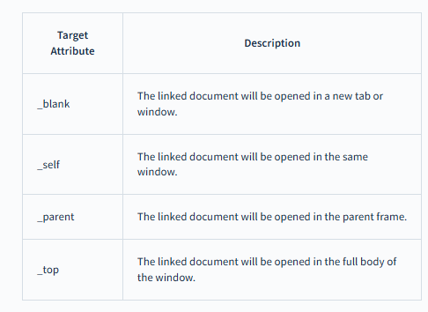
Anchor Tag Attributes
Ex: -
<a href="http://codingwithsudhir" target="_blank">click here</a>

Slide 4
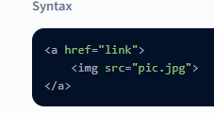
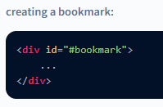

Using an Image as a Link
Images can be used as HTML links. We can associate a document with an image such that, upon clicking on it the user will be redirected to that document.
To use images as HTML links, we need to add an <img> tag inside the <a> tag.
Creating a Bookmark Link for a Webpage
We can create a bookmark for a specific section of the page using HTML links, such that upon clicking on that link, we would reach that particular section.
Syntax

Slide 5

Download Links
We can create links upon clicking on which, a file can be downloaded.
To create download links, we need to add the download attribute within the <a> tag.
The browser will automatically assign the correct format of the file that is being downloaded and we do not need to mention anything.
The download can take a value that will specify the default name for the file. Although passing this value is not mandatory.

